Slide 1
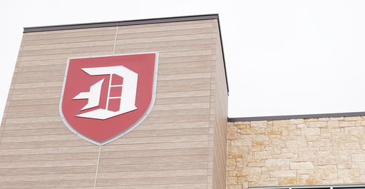
School board Meeting
March 2023

Slide 2
Session Agenda
Enrollment Update
Staffing Update
Curriculum & SEL
STEM update
Data Presentation by Dr. Jessica Barr, Data Consultant
Extracurricular

Slide 3
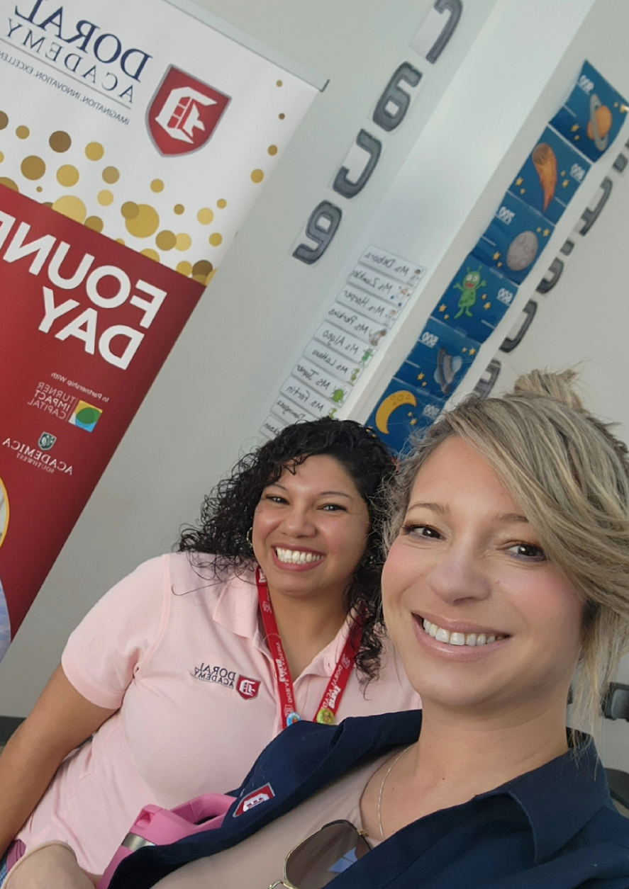
Enrollment numbers
Started with 360 – Maintained at 353
Founder’s Day – 60 new families visited and prospect hires

Slide 4
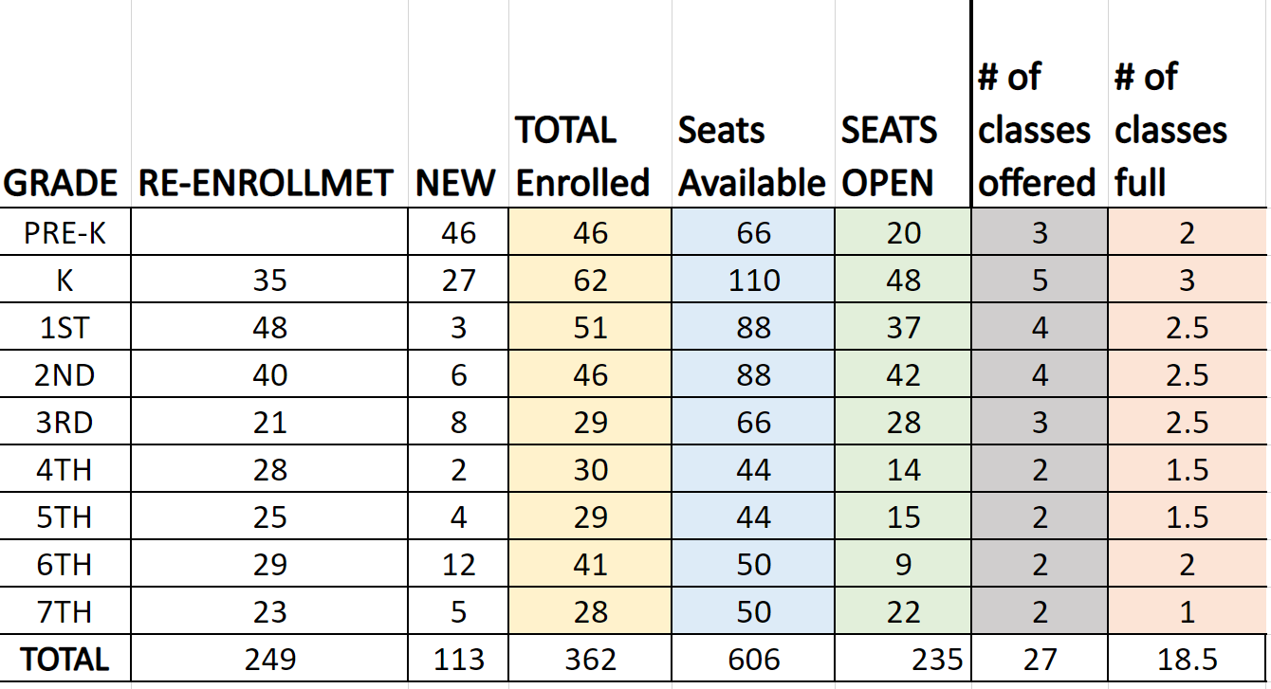

Slide 5
Enrollment process
Prospect Families apply on schoolmint
Registrar schedules school tours to meet admin. and experience a brief day in the life of a Doral Eagle
Families upload documents and complete registration. #CustomSweatshirt & Swag

Slide 6
Feedback from prospect families
Parents saw Ms. Meyer interacting with a student who needed the extra help while the class continued to do their work quietly. Ms. Joyner, parents loved what you do to help your kiddos keep focus even when they are not able to sit still. Ms. Donaldson your display of students' art work from art club is always an eye catcher and parents comment on how students are very talented.
Mrs. Kliber thank you for allowing me the time to show parents the environment in which our students are in and for talking to parents as we stop by your door. Parents really appreciate it.
Ms. Reyes (Pre-K) and Ms. Zumkley (1st Gd) the display of your kiddos picture on the bulletin board outside the classroom is a big hit, parents love how our little ones are interacting with our Black History Month activities.
Fifth Grade Team Ms. Fortin, Ms. Haley, and Ms. Mazzacano I have heard nothing but great things from parents about the work that is happening with in the classrooms when we have stopped by. Parents love to see the interactions with the students. Ms. Haley parents love the way your class is decorated with all the planets, I have heard so many complements. Ms. Mazzacano the fact that you incorporated your students' name as a way to teach fractions is amazing, parents are so impressed by it.
Ms. Kemmerling the Amazon Rain Forest project is also a great hit with our incoming parents, they are amazed at the talent your students have and the knowledge on their project as they get to read some of their research.
Coach T thank you for allowing me to show the activities parents see when we stop by. Parents really enjoy seeing what you are doing in PE and are glad they are getting their exercise in 😂
Your HARD work is really showing as parents and I approach classrooms and we see all students learning and being attentive. Parents have so many positive things to say about what they see.

Slide 7
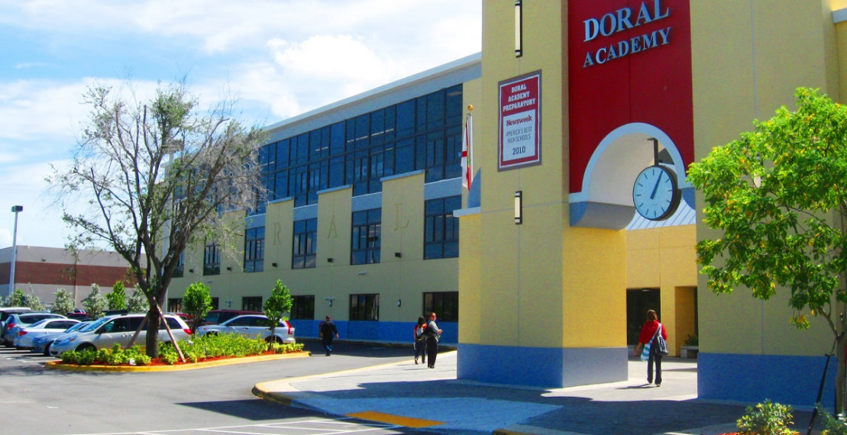
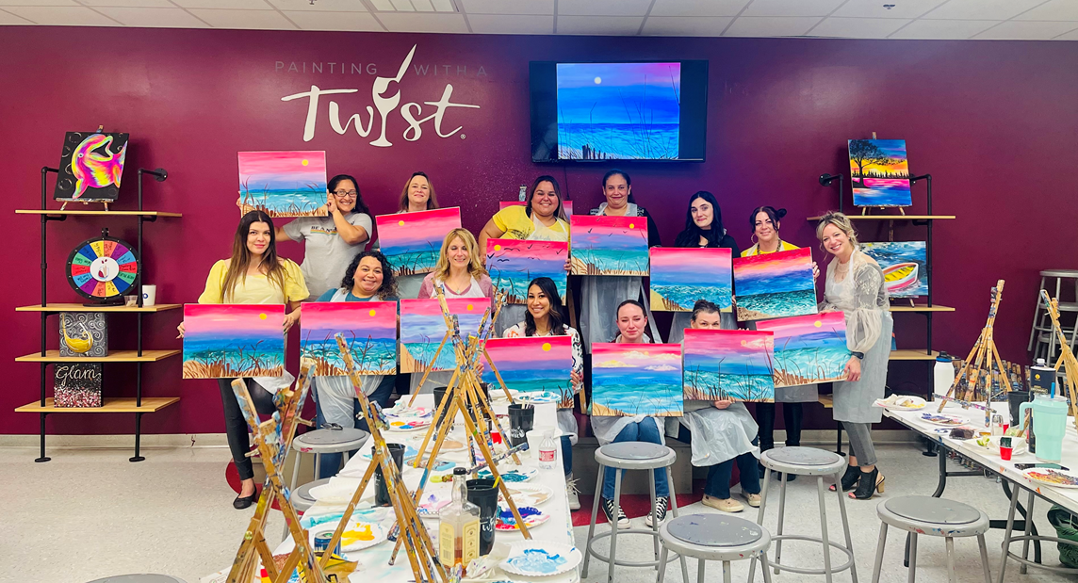
Staffing update
22-23 Vacancies: Interviewing and onboarding
Office Manager & Prek Teacher
23-24 SY:
Offers made and accepted for Kinder, Second, Upper grades, and teacher assistants.
Two of them within the Network ☺
Job Fair – Late Spring/Early Summer
Intent Forms – Will be shared by April 1st
Teambuilding:
Painting with a Twist
Buff City Soap

Slide 8
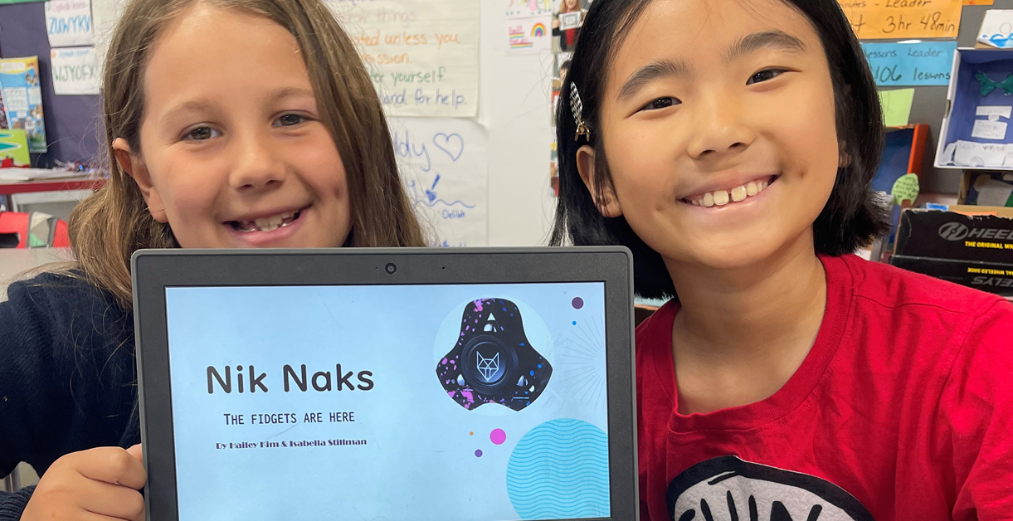
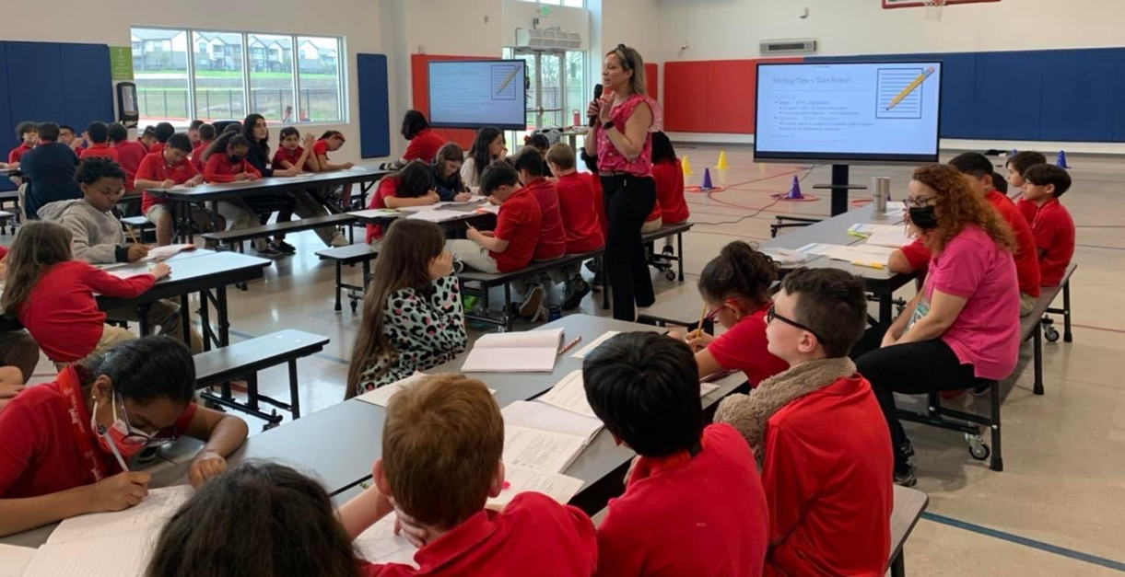
Curriculum updates
2023-2024 Master Schedule is complete (draft form)
Accelerated Reader – 3rd quarter
STAAR Writing Workshops
Planetarium Visits Doral
Educational Fieldtrips
I-Ready GM in March
STAAR Interims
Subject selections – April
STEM support – Doral Miami
Snapology – Summer Programs at Doral
Locorobo Innovations
Wedo2.0 - Lego

Slide 9
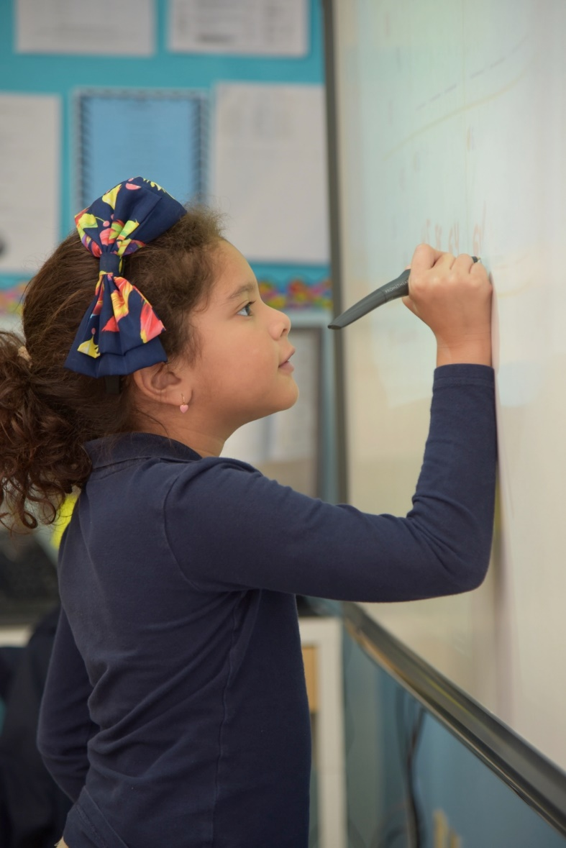
Doral academy of Texas (K-8)
Students learn in an innovative environment fostered by the use of advanced teaching methods and technology
Mission: To provide a rigorous and relevant curriculum, which focuses on science, technology, engineering, and mathematics (STEM).
The curriculum ensures that all students meet and exceed the state standards in Math, Science and Reading
grades K-5: STEM programs are embedded in the curriculum
*grades 6-8: engineering, robotics and video game design courses
*Advanced/Pre-AP coursework and high school credit courses

Slide 11
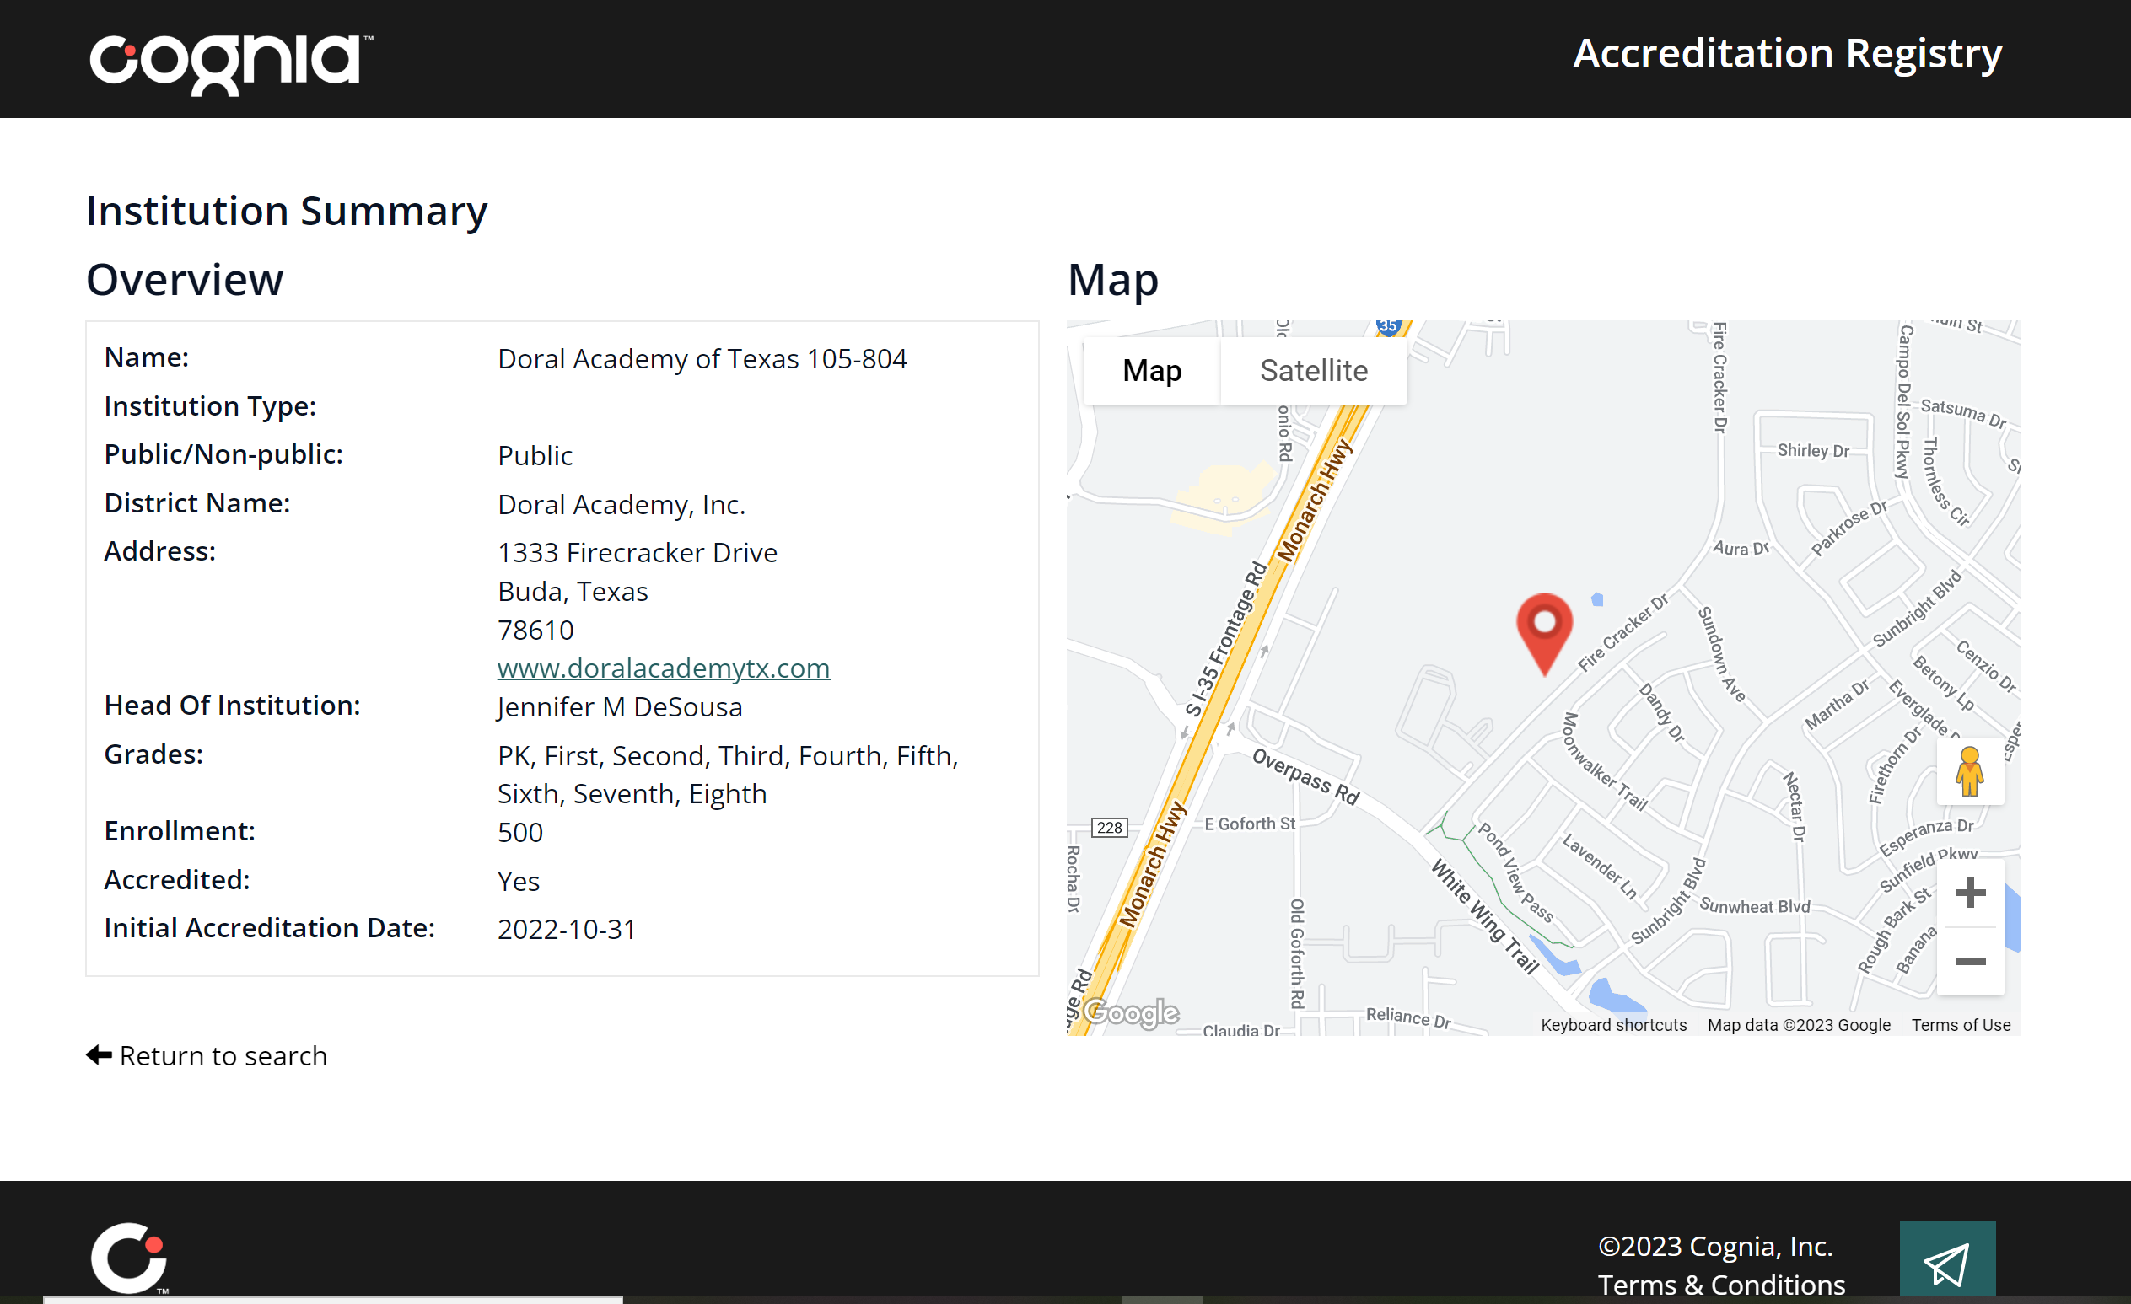
We are an accredited school

Slide 13
Ttess – teacher appraisals
Teacher Appraisals are scheduled, and observations have started
TIA focus – not only recruit, but also retain highly effective teachers

Slide 14
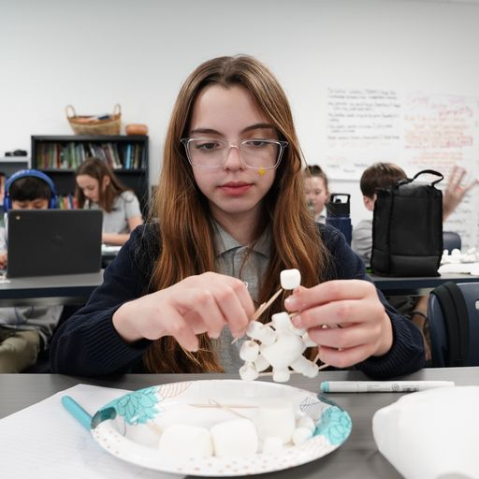
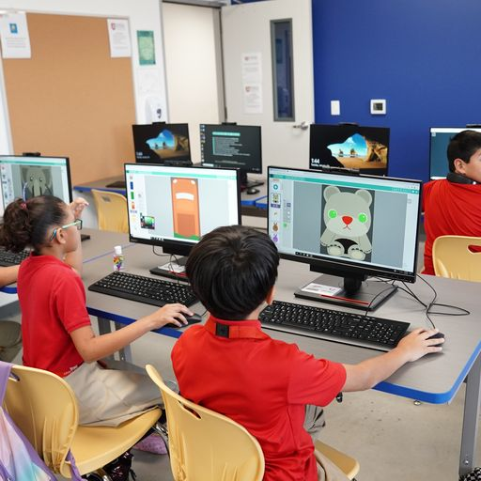
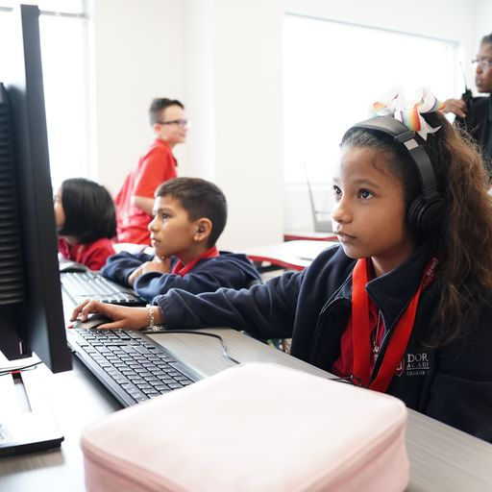
Curriculum in Action!

Slide 15
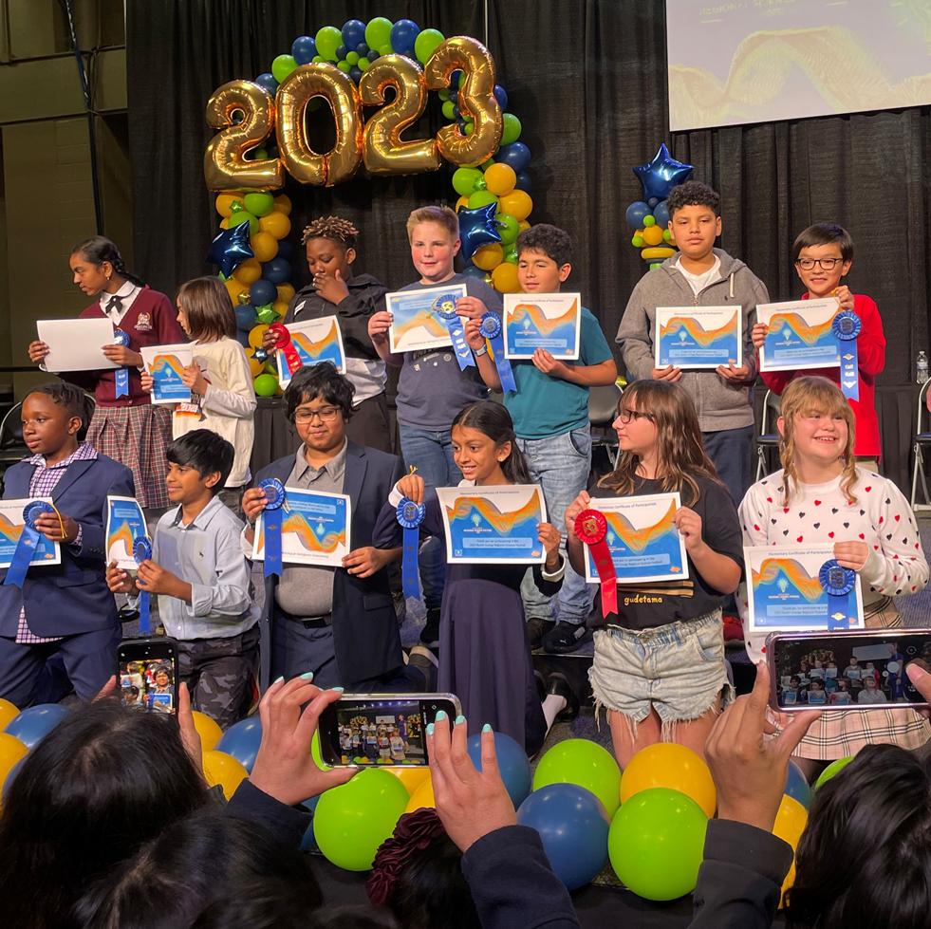
Stem updates:
22-23 school year accomplishments:
- technology in every classroom
- computer labs
- STEM assembles/ presenters
- Regional science fair participation
- Science Fair projects K-6/ Science Fair night
- STEM time daily/www.code.org
- esports/ gaming club
- STEM SCOPES - Engineering Kits by grade
- monthly STEM challenges
- STEM symposium Professional Development for teachers and admin. (April)
23-24 school year goals:
- complete STEM lab with 3D printers
- Robotics Club
- middle school STEM electives: into to technology/Robotics
- Lego Wedo.2.0 program for elementary curriculum
- increase number of devices in each classroom
- add Digital Music/ music elective
- science related field tips to enhance instruction
- participate in UIL academic competitions- science and math
- continued Professional developments

Slide 16
Special Areas
Students will receive instruction in the following areas:
Art
PE
Spanish
Technology will be embedded into the curriculum

Slide 17
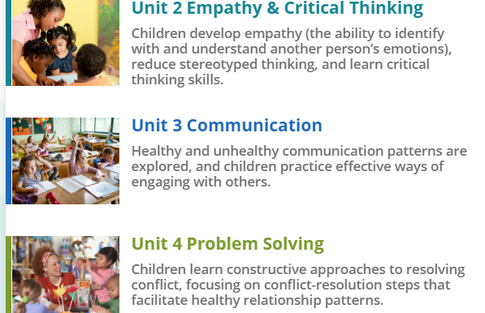
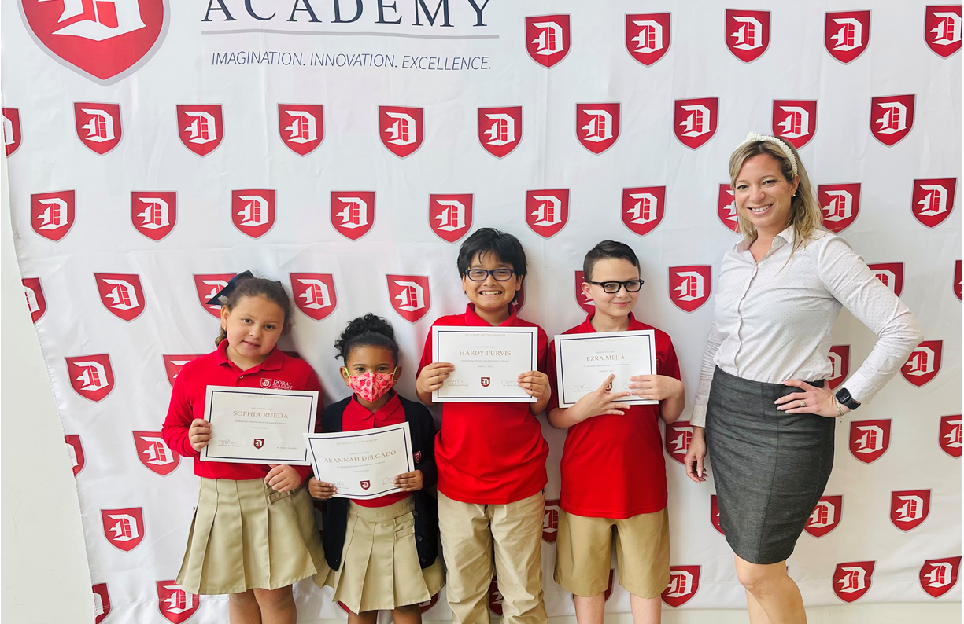
Social emotional curriculum

Slide 18
Data-Driven District
Doral Academy administers Diagnostic Assessments to all students
Remediation and Enrichment will be offered as needed and progress will be monitored
Evidence of D.I. in every classroom
PLP- Personalized Learning Plans

Slide 19
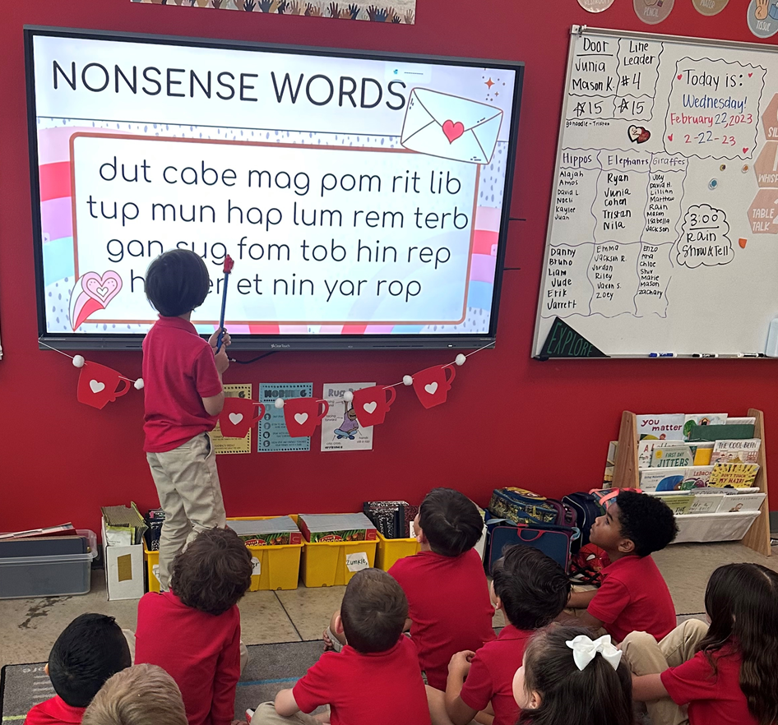
Data presentation Dr. Jessica barr
https://www.loom.com/share/6ef3e84daf9349d797f0fee0733fa12b

Slide 20
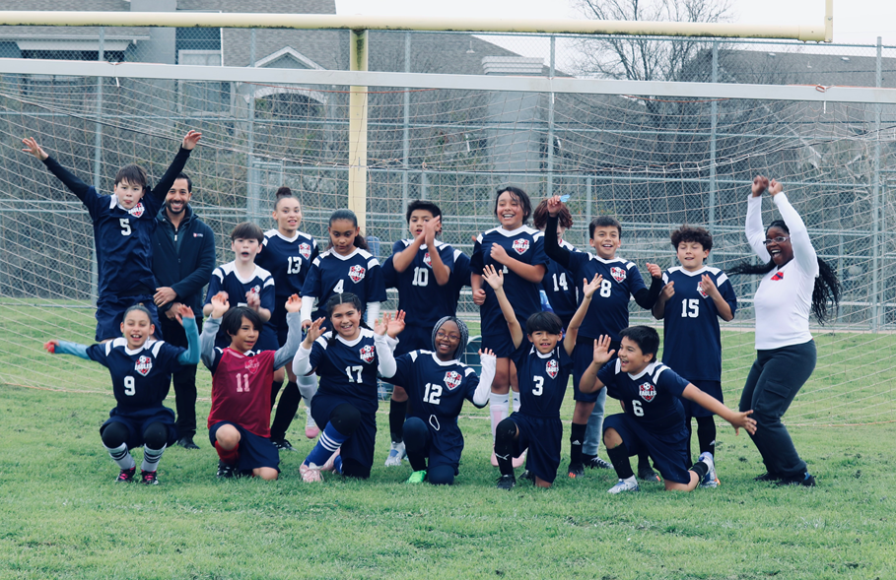
Extra curricular
Activities
EOY ceremonies and promotions/graduations
Sports
Girls' basketball division champs
Soccer (co-ed) (2-1)
Clubs
Drama Club – Alice in Wonderland Production
Choir – Spring Show

Slide 21
Volunteer Opportunities:
Garden Project
Assemble library Bookshelves
Decorate Bulletin Boards
Hang bulletin boards
Doral Closet
Organize Lost and Found bins

Slide 22
Teacher appreciation week
May 8 – May 12 Teacher gift ideas will be shared with families ☺
Looking for community sponsors to donate coffee and snacks for staff! ☺

Slide 23
Art show/ptsa family picnic
Join us on Saturday, April 29th 12 – 4 PM.
Doral student artwork will be displayef
Student artwork silent auction
Bring your picnic blankets/lawn chairs
Community vendor booths
Food trucks and
Great company!

Slide 24
Save the dates!
PreK Graduation Photos – April 11th
PreK, Kinder, and EOY Awards Ceremony for 5th & 6th grade – May 24th
PreK 8:30 AM
Kinder 11 AM
5/6 th grades – 1 PM
Field Day – May 25th

Slide 25
Summer 2023
ESY during the month of June for targeted students
SNAPOLOGY summer STEM programs ☺
Kinder Screeners
PREK screening
Week of July 4th – offices closed
Summer Hours – 9:00 – 2:00 PM and closed on Fridays

Slide 26
Stay connected!
www.DoralAcademyTX.com
@DoralAcademyTX

Slide 27
“Alone we can do so little, together we can do so much”.
- Hellen Keller
“If everyone is moving forward together, then success takes care of itself”.
- Henry Ford

